Slide 1


AI-Driven Traffic Signal Violation Detection System
This presentation introduces an AI-driven solution for detecting traffic signal violations. The system enhances traffic law compliance and reduces road accidents through real-time monitoring.
by Tejaswi Nakka

Slide 2
Core Technology: Computer Vision and Deep Learning
Computer Vision
Deep Learning
Computer vision analyzes video feeds. It extracts relevant information about vehicles and traffic signals.
Deep learning models interpret the visual data. It identifies violations based on learned patterns.

Slide 3

Real-Time Object Detection with YOLOv8
1
YOLOv8
YOLOv8 provides real-time object detection. It precisely locates vehicles and traffic signals in video frames.
2
Speed and Accuracy
YOLOv8 balances speed and accuracy. It ensures rapid processing without compromising detection quality.

Slide 4



Video Processing with OpenCV
OpenCV
Stop Line
OpenCV handles video processing. It stabilizes video and enhances image quality.
Users manually select a stop line. This defines the area monitored for violations.

Slide 5
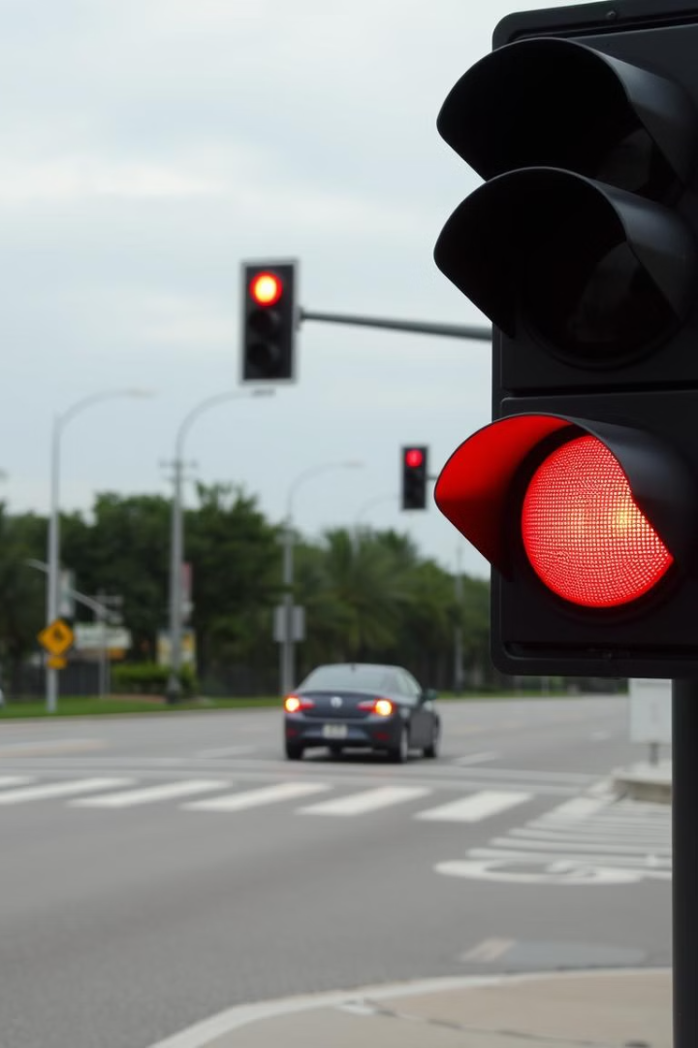



Violation Marking and Tracking
Red Light Cross
Vehicle crosses stop line during a red light.
Violation Detection
System marks the vehicle as a violator.
Highlighting
Violating vehicle is highlighted for 1 second.

Slide 6
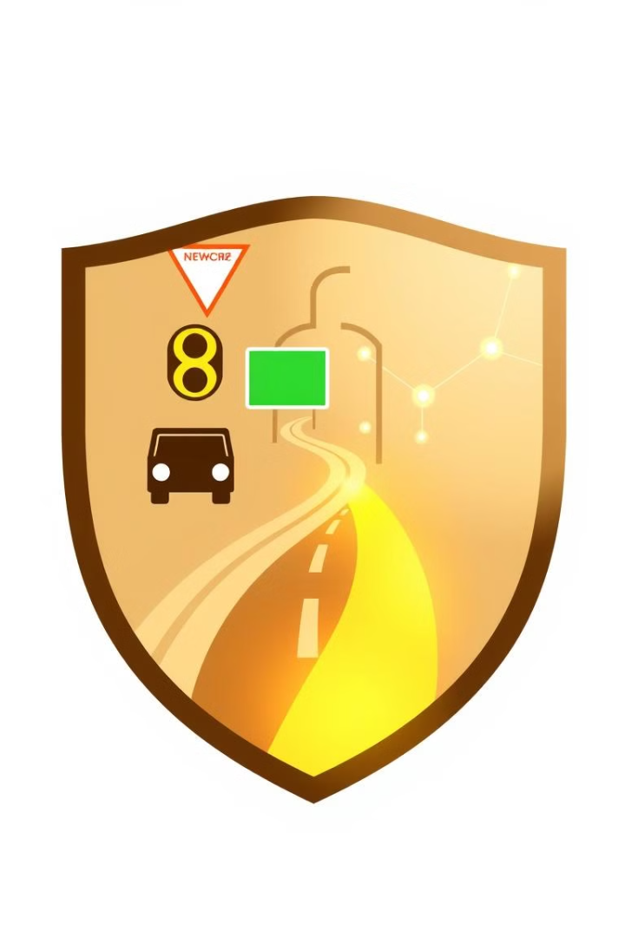
Benefits of Automated Enforcement
Eliminates Manual Enforcement
Enhances Compliance
Increases adherence to traffic laws.
Reduces the need for human monitoring.
Reduces Accidents
Contributes to safer road conditions.

Slide 7

Scalability and Integration
Real-Time Applications
1
Scalable for high-demand environments.
2
Existing Systems
Integrates with current surveillance setups.
Future Expansion
3
ALPR integration for automated ticketing.

Slide 8

Key Takeaways and Next Steps
1
AI-Driven Solution
2
Improved Safety
The system automates traffic violation detection.
It leads to enhanced road safety and compliance.
3
Future Development
Further ALPR integration is planned.

